Slide 1
Human Activity Detection
2CS501 - ML

Slide 2
Our aim
Analyse a Human Activity Recognition (HAR) dataset with six different activities.
Utilize machine learning models including Random Forest (RF), Logistic Regression (LR), Long Short-Term Memory (LSTM), Support Vector Machine (SVM), and Naive Bayes.
Evaluate the accuracy of each model in classifying the activities.
Identify the most accurate model among RF, LR, LSTM, SVM, and Naive Bayes.
Visualize the models' performance by plotting Area Under the Curve (AUC) using ROC analysis.

Slide 3
ML and DL models to be implemented
Naïve Bayes
Support Vector Machines
Random Forest
Logistic Regression
Long Short Term Memory

Slide 4
Feature Scaling and Label Encoding
Feature scaling using Standard Scaler
Standard Scaler is a data preprocessing technique based on Z-score normalization to rescale features to have a mean of 0 and standard deviation of 1.
As the values from the different devices used vary in magnitude and range, feature scaling helps eliminate the problem of features with larger scales dominating the learning process.
Encoding of labels using Label Encoder
Label Encoder is a preprocessing technique used to convert categorical/text labels into numerical labels.
This technique is used to convert the categorical labels of ‘Activities’ [LAYING, SITTING, STANDING, WALKING, WALKING_DOWNSTAIRS, WALKING_UPSTAIRS] into numerical labels

Slide 5
Naïve Bayes
The Naïve Bayes classifier is a probabilistic machine learning algorithm that is well-suited for classification tasks. Steps involved are:
Creating a NB model using the Gaussian Naïve Bayes (GaussianNB) classifier.
Training the Gaussian Naïve Bayes model on X_train and y_train and making predictions on the test data. Then a classification report it generated which provides a detailed report for each class, including precision, recall, F1-score, and support. This report will help you assess how well your Gaussian Naïve Bayes model is performing for each class.
A confusion matrix was built using true labels (y_test) and predicted labels (NB_predicted) to further analyse the performance of GaussianNB classifier by extracting various metrics from this matrix. A heatmap is generated to visualize the matrix using colours to represent the values in the matrix and identify patterns. The diagonal cells are represented correctly predicted samples and off-diagonal cells represent the misclassified samples.

Slide 6
Why is NB used for HAD?
NB model serves as a baseline model for comparison with other ML and DL models due to its relative ease of implementation and interpretability.
The model can perform well even with imbalanced data.
The model becomes applicable due to feature engineering of given data into numerical values for classification problems.
Accuracy of the model is 0.67.

Slide 7
Support Vector Machines
Human activity detection often uses data from various sensors, such as accelerometers and gyroscopes which generate high-dimensional data. Thus, SVM classification is used as it is well-suited for high-dimensional data because it can find an optimal hyperplane that separates classes. The steps involved are:
SVM model is created with hyperparameters as follows:
Gamma = 'auto' (controls the shape of the decision boundary) which means it will be calculated as 1 / n_features.
C = 10 is the regularization parameter. A smaller C value encourages a larger margin but may lead to misclassified training examples, while a larger C value results in a smaller margin but fewer misclassifications.
Kernel = 'rbf' specifies the radial basis function kernel, which is commonly used to model complex, nonlinear decision boundaries in SVMs.\
Probability = True allows the SVM model to calculate class probabilities using the predict_proba method.

Slide 8
Why is SVM used in HAD?
SVM provides a globally optimal solution, i.e, it finds the best possible decision boundary for minimizing misclassification.
Kernel trick allows transformation of data into higher-dimensional space which helps in capturing complex relationships in the data for modelling human activities.
SVM can also learn about the relationship between features even for nonlinear datasets.
Accuracy of the model is 0.98

Slide 9
Random Forest
Random Forest (RF) is an ensemble learning method that combines multiple decision trees to make predictions.
It uses multiple decision trees, which are flowchart-like structures used for classification and regression.
Each tree is trained on a random subset of the data, created through bootstrapped sampling (random sampling with replacement).
At each split in a tree, only a random subset of features is considered, adding diversity to the forest.
For classification, predictions from trees are combined via majority voting. For regression, predictions are averaged.
Hyperparameters:
Max_depth: maximum number of children nodes that can grow out from the decision tree until the tree is cut off.
N_estimators: Number of trees the algorithm builds before averaging the predictions.
Random_state: controls randomness of the sample. The model will always produce the same results if it has a definite value of random state
Accuracy of model is 0.98

Slide 10
Why is RF used in HAD?
The ensemble nature of Random Forest helps in reducing overfitting, making it more accurate on unseen data.
Can handle large datasets with many features (high dimensionality) effectively.
Provides a feature importance score, indicating which features are more influential in making predictions.
Efficiently handles large datasets with parallelization.
Does not totally depend on a particular feature as not all features are used in each DT

Slide 11
Logistic Regression
LR is a ML model used to classify data into two or more groups.
When used to classify into more than two groups, it divides all the groups into combinations of two, with each group on one side and the rest of the classes on the other.
The probability that the data element belongs to each class as compared to the rest of the classes is found, and the class with the highest probability is chosen as the right class.
The probability of the test element is found using the sigmoid function.
The sigmoid function gives a value between 0 and 1 (both included), which makes it easy to classify into one of two groups (0 for one and 1 for the other).
Sigmoid: f(x) = 1/1+e^{-z} ;ranging from [0,1]
The model uses softmax regression which is generalization of logistic regression for multinomial classification.

Slide 12
Why is LR used in HAD?
LR is a fairly easy model to implement and offers high interpretability.
Can handle multiclass classification by using Softmax regression
It is found to be efficient when used with large or extensive datasets, which is proven by the fact that its accuracy is 0.98.
It is one of the most basic machine learning models to establish a baseline performance.

Slide 13
Long Short Term Memory (LSTM)
LSTM is a DL algorithm and a special kind of RNN model explicitly designed to avoid the long-term dependency problem otherwise known as vanishing or exploding gradient problem.
Vanishing or Exploding gradient problem occurs when there are long sequences of data which make it difficult for the model to learn from past information.
LSTM consists of memory cells that store and access information over extended sequences with the help of gates.
The three types of gates are: Forget gate, Input gate and Output gate
Forget Gate: determines what information from previous time step should be retained or forgotten.
Input Gate: controls the flow of information to be added into the cell.
Output Gate: decides which information from the cell should be used as output of the LSTM unit.

Slide 14
Activation functions used are tanh and sigmoid functions.
Sigmoid: f(x) = 1/1+e^{-z} ;ranging from [0,1]
tanh: f(x) = 2/(1 + e ^{-2x}) - 1; ranging from [-1,1]
Terminologies
Dropout Layer: used to prevent overfitting in the network by setting a percentage of inputs units to 0 at each updation.
Dense Layer: fully connected hidden layer which maps the output from previous layers to desired output space. They are suitable for both classification and regression tasks.
ReLU (Rectified Linear Unit) function: f(x) = max(x, 0) - introduces non-linearity into the model. It also suppresses information on the basis of whether the input was positive or negative.
Softmax function: transforms the output into multinomial probability distribution for multi-class classification problems. It is usually used when the model needs to choose from multiple inputs.
Categorical Cross-Entropy loss function: used to quantify how well the predicted class probabilities match the actual class labels.
Adam Optimizer: is an optimization algorithm used to update the weights of the network iteratively during training.

Slide 15
Why is LSTM used in HAD?
As the dataset contains long sequences of data collected accelerometer and gyroscope readings, LSTM model is specifically designed to handle such sequential data.
Data collected from human activities exhibit dependency on the order and timing of sensor readings. The model is able to capture such dependencies to recognize complex human behaviour.
Learning and remembering patterns and correlations between data over time is another important factor for choosing LSTM.
Parallel processing is possible due to LSTM, thereby increasing the computational efficiency.
Accuracy of the model is 89.338% (+/-1.048)

Slide 16
Confusion Matrix
Performance evaluation tool which measures various variables and provides a detailed summary of the model’s prediction values for a classification problem.
True Positive (TP): cases predicted correctly for event values.
True Negative (TN): cases predicted correctly for no-event values.
False Positive (FP): cases predicted incorrectly for event values.
False Negative (FN): cases predicted incorrectly for no-event values.
Precision: # of correctly predicted events turned out to be positive = TP / (TP + FP)
Recall: measure of model’s ability to correctly predict positive instances = TP / (TP + FN)
F1 Score: harmonic mean of precision and recall to measure overall accuracy = 2 * (Precision * Recall) / (Precision + Recall)
Support: refers to # of samples in each class
Macro Averaging: calculates the average of evaluation metrics across all classes without considering class imbalance.
Weighted Averaging: calculates the average of evaluation metrics across all classes while accounting for class imbalance.

Slide 17
AUC and ROC curve
ROC curve (receiver operating characteristic curve) is the graphical representation of a classification model at varying thresholds. The curve plot two parameters, True Positive Rate (TPR) and False Positive Rate (FPR) at y and x axes respectively.
TPR = TP / (TP + FN)
FPR = FP / (FP + TN)
TPR - Rate of positive samples being classified correctly.
FPR - Rate of negative samples being misclassified.
A no-skill classifier curve is a diagonal line drawn from the bottom left of the plot to the top right. This line cannot discriminate between the classes and would predict a random or a major class in all cases.

Slide 18
AUC (Area under the curve) is the measure of the two-dimensional area under the ROC curve representing the aggregate measure of performance of a classification model.
A model having AUC of 1.0 means that the model classified all examples correctly. A random model may have an AUC of 0.5.
The closer the AUC is to 1, the better the performance of the model.
AUC serves as a effective parameter for comparison of various models on the basis of their performance.

Slide 19
Functions to evaluate ROC curve
predict_proba() calculates the predicted probabilities for each class. For a single sample, the class with the highest probability is the predicted class. This allows us to set a threshold to determine the final class label.
roc_curve() calculates the TPR and FPR at different thresholds to evaluate the performance of the model using ROC curve.
roc_auc_score() calculates the AUROC for a model to assess its performance. The score indicates the ability of a model in discriminating between different classes in multiclassification problems. The ‘ovr’ stands for ‘One-Versus-Rest’ which indicates the mode of calculation where AUC is calculated by treating one class as “positive” while the rest are treated as “negative”. The final AUC is obtained by averaging the individual AUC values.

Slide 20
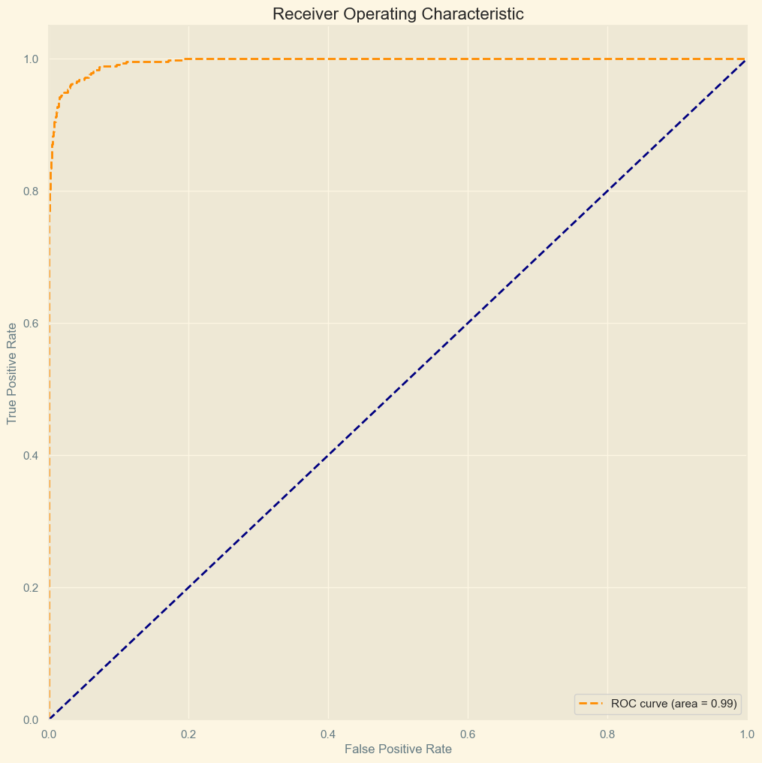
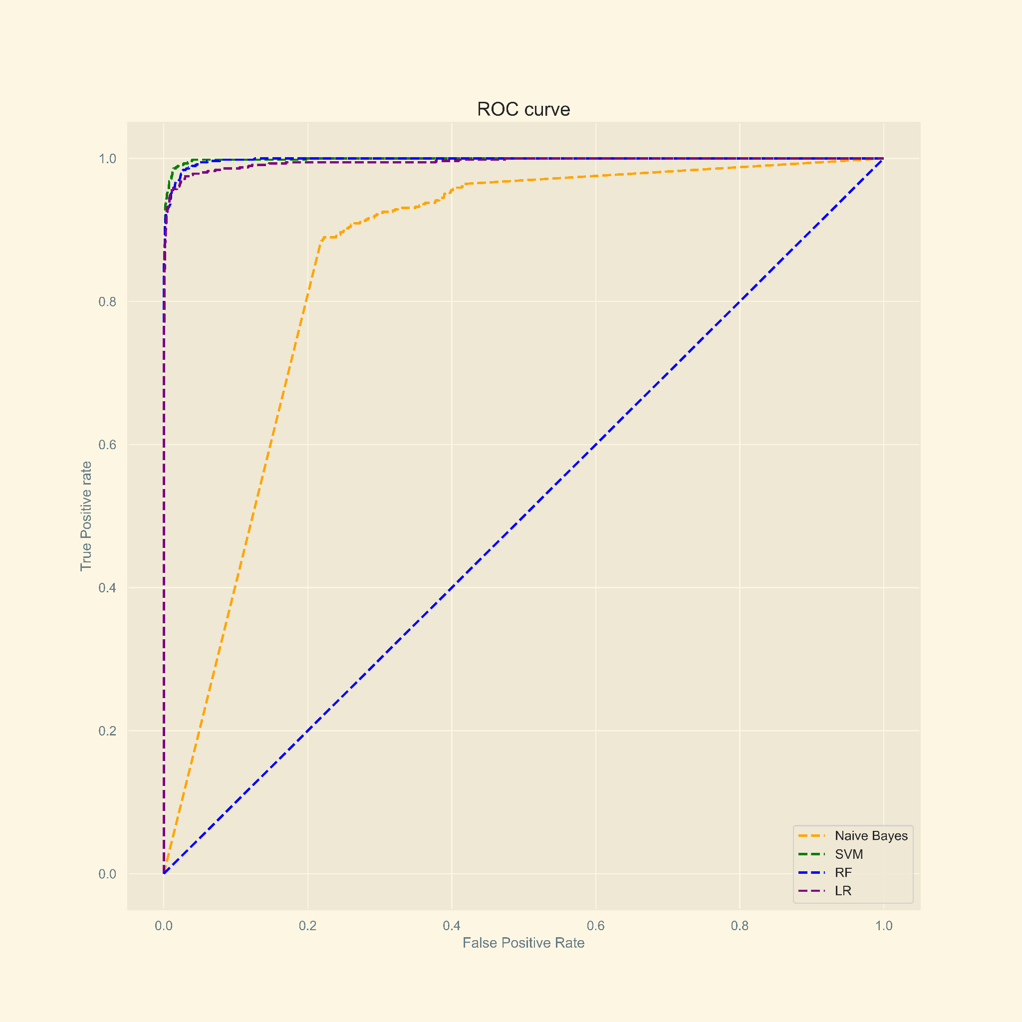
AUC graphs
AUC values of the models used: LSTM = 0.99
LR = 0.99
RF = 0.99
SVM = 0.99
NB = 0.95

